Slide 1
OBJECT DETECTION USING DEEP LEARNING
Submitted in the partial fulfillment for the award of the degree of
BACHELOR OF ENGINEERING
IN
ARTIFICIAL INTELLIGENCE AND MACHINE LEARNING
Submitted by:
Vupputuri Bharath (20BCS6586)
Kethuri Ajay (20BCS6585)
Aman Mishra (20BCS6594)
Aman Shukla (20BCS6568)
Under the Supervision of:
Ms. Sukhman Kaur
Department of AIT-CSE
DISCOVER . LEARN . EMPOWER

Slide 2
Outline
Introduction to Project
Problem Formulation
Objectives of the work
Methodology used
Results and Outputs
Conclusion
Future Scope
References

Slide 3

Introduction to Project
Object detection using deep learning uses image classification. Image classification is a supervised learning. Image classification involves classifying the detected objects based on the labeled classes provided for particular type of objects such as person, book, mouse, some kind of animals and so on.
Object Detection is the science of detecting any object that is present within the provided frame of the field of view of the model.
Object recognition refers to a set of related tasks for recognizing object or classifying in one of the pre provided labels in digital photographs such as images, videos or even live inputs.

Slide 4
Image classification algorithms generates a set of object classes present in the image. Object detection algorithms generates a set of object classes present in the image with an axis-aligned box specifying the location and scale of each instance of each object class. The efficiency of a model on image classification is gauged using the mean classification error throughout the predicted class labels.
This is brief about object detection. Let’s discuss more…

Slide 5
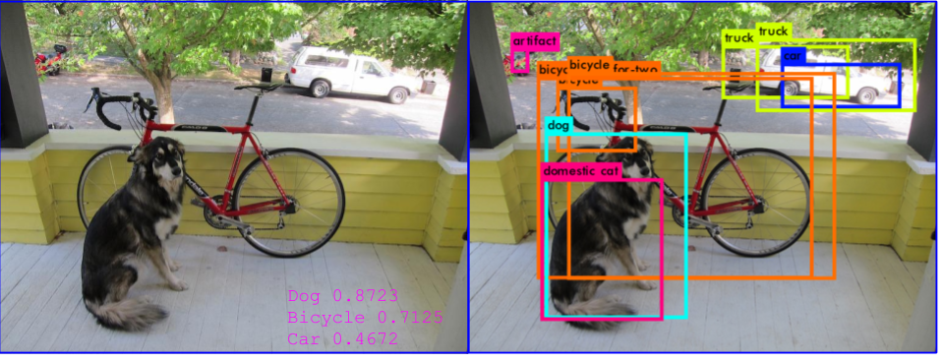
Problem Formulation
What amount of significant objects are present inside a given input? (Object Detection)
Where in the input are the detected images located? (Object Detection)
What classes do the following objects belongs to and how closely it resembles the labeled class? (Object Recognition)

Slide 6
Objectives of the Work
To find all the objects present inside a given input whether it is images, video or even live inputs from web cams and cctv.
To correctly determine and detect the location of objects crossing a certain threshold of significance (size relative to other objects) in the inputs.
To recognize the objects detected in the frame accurately determining its class from the set of given labeled classes.
Finally, to build a working application of the entire set of recognizing all kinds of inputs whether pre defined such as videos or live feed from web cam with Graphical user interface to make it easy to navigate and control the working.

Slide 7
Methodology used
This object detection model uses deep learning particularly Convolutional neural networks (Cnn’s) for training with the help of a python library known as Open ComputerVision known as OpenCV which is based on Deep Neural Networks(DNN).
The model constructed form the library works by resizing the inputs converting the inputs into feature vectors with the help of numpy arrays which then are matched with labeled classes to recognize the inputs.
For this project we have used MobileNetSSD pre trained model with coco dataset containing 91 labels on which the model has been trained.

Slide 8
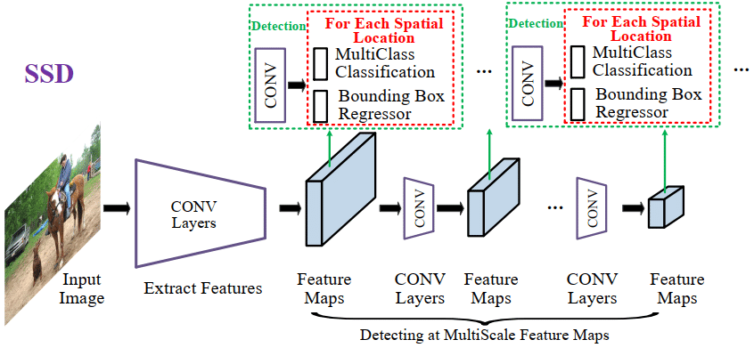

Slide 9
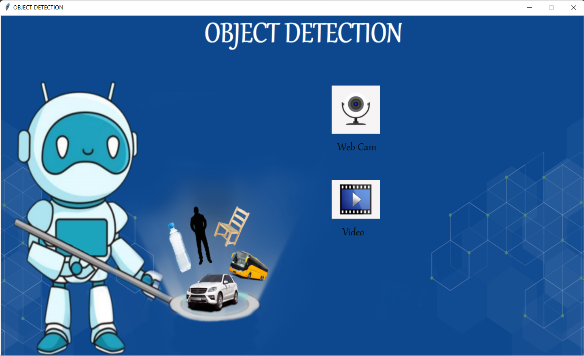

Slide 10


Slide 11
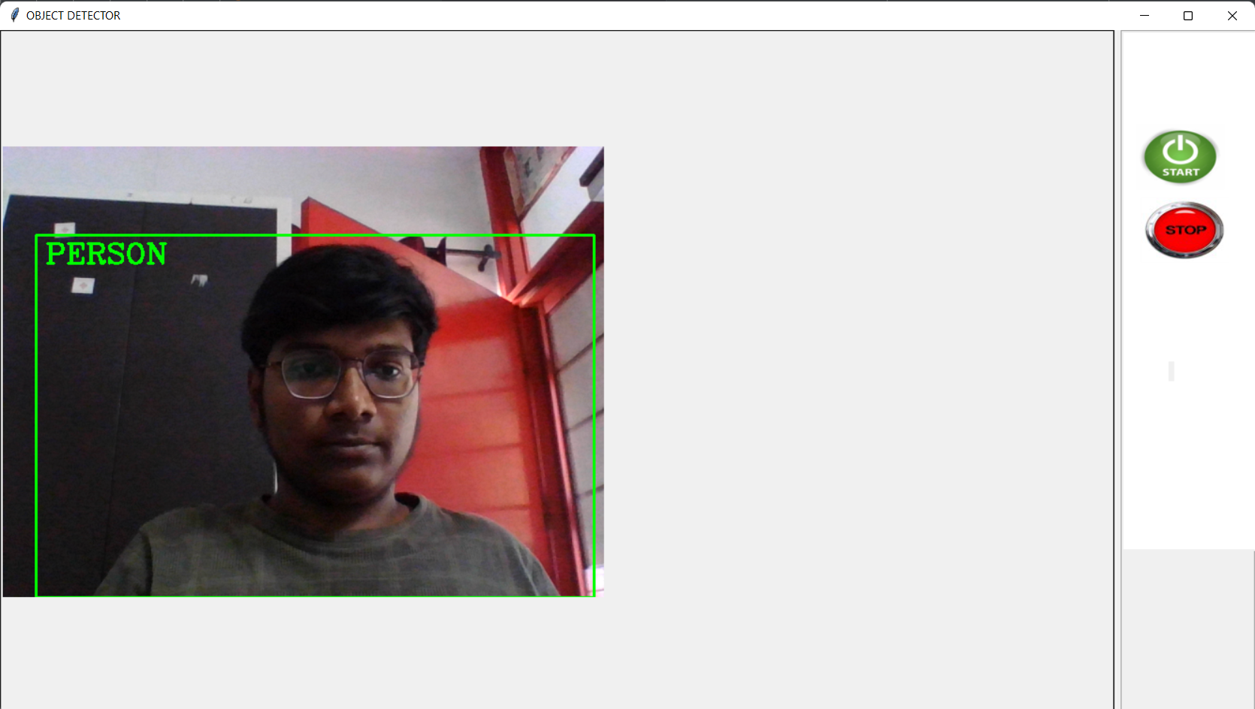

Slide 12
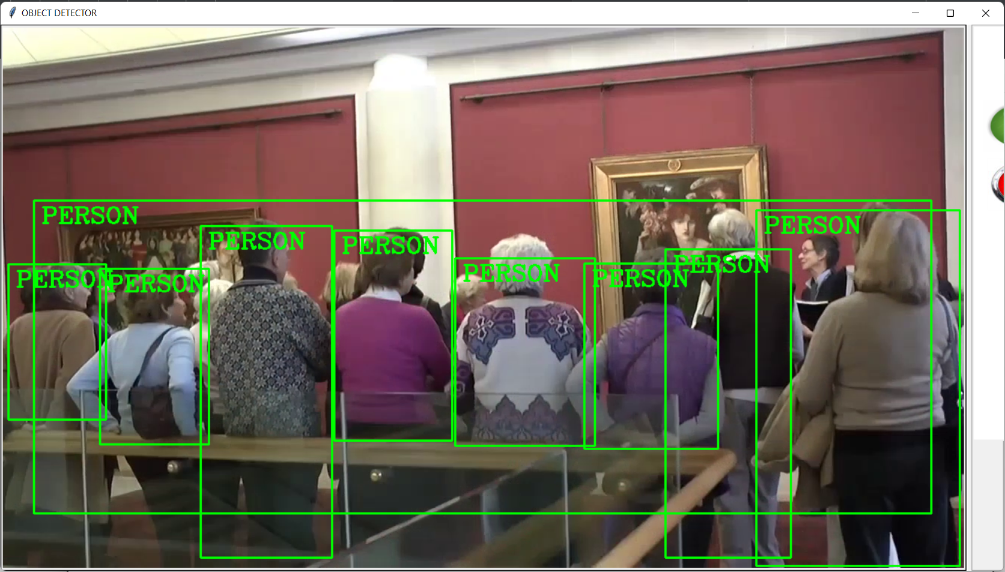

Slide 13
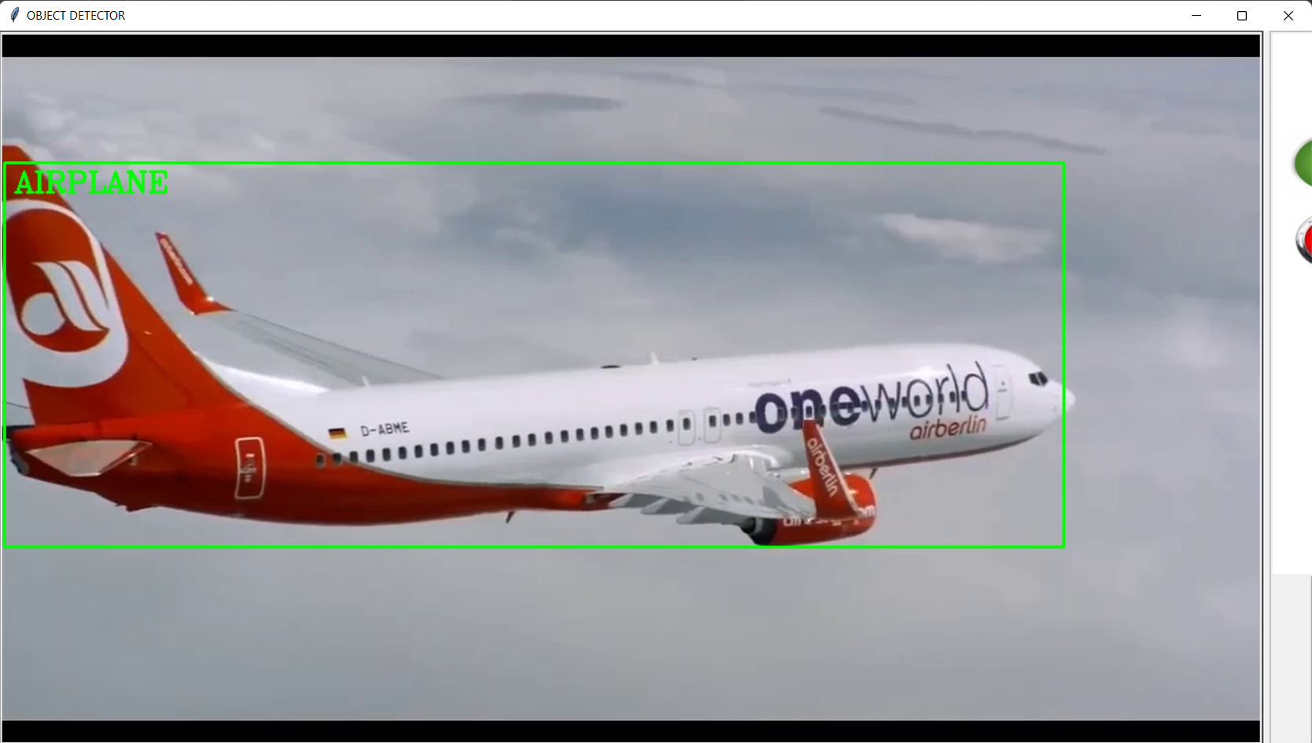

Slide 14
Conclusion
Our object detection is based on openCV which resides on the framework of neural networks to correctly detect objects within the frame of view.
The model uses MobileNetSSD pre trained model which is trained on coco dataset containing 91 image labels to recognize the object with satisfactory accuracy and quick speed.
All the features of detection and recognition of all types of inputs like videos and live inputs are packed in a bundle with the help of tkinter graphical user interface library.

Slide 15
Future Scope
The Project can be further extended to even recognize facial expression like joy, sad and angry.
The project can be developed for images as well to cover all the types of inputs.
It can be used in security systems to avoid breaching and break ins.
It can also be used as an alternative check in system to avoid contactless check in rather than biometric which requires contact.
It can also be used in education filed to train small children and individuals with mental challenges to learn about all the objects they see in images, videos and also around them with web cams.

Slide 16
References
[1] Manjula S, Lakshmi Tamilselvan (2016) A study on object detection.
[2] Jun Deng, Xiaojing Xuan, Weifeng Wang, Zhao Li, Hanwen Yao, Zhiqiang Wang (2020) A review of research on object detection based on deep learning.
[3] Ajeet Ram Pathak, Manjusha Pandey, Siddharth Rautaray (2018) Applications of Deep Learning for object detection.
[4] Sunil, Gagandeep (2019) Study of object detection methods and applications on digital images.
[5] Zhong-Qiu Zhao, Shou-tao Xu, Xindong Wu (2017) Object detection with deep learning: A review.
[6] Jun Wang Tingjuan Zhang, Yong Cheng, Najla Al-Nabhan (2021) Deep Learning for Object detection: A survey.
[7] C.Stauffer and W.Grimson.Adaptive background mixture models for real-time tracking. Proceedings of IEEE Conf.Computer Vision and pattern Recognition,vol.2,1999, 246-252.
[8] Girshick, R., Donahue, J., Darrel, T.,Malik, J. Rich Feature Hierarchies for Accurate Object Detection and Semantic Segmentation. In: Computer Vision and Pattern Recognition. Columbus.2014, pp. 580-587.
[9] Ren, S.Q., He, K.M., Girshick, R., Sun, J. Faster R-CNN: towards real-time object detection with region proposal networks. In: Advances in neural information processing systems. Montreal.2016, pp. 91-99.
[10] Liu, W., Anguelov, D., Erhan, D., et al. SSD: Single Shot MultiBox Detector. European Conference on Computer Vision, 2016, pp. 21-37.
[11] Dr. Sabeenian R.S, N Deivanai (2020) Wild animals intrusion detection using deep learning techniques.
[12] Khyati Zalawadia ,Helly Shah ,Radhika Shringarure (2015) Traffic Detection and Diversion System: Case Study

